Slide 1
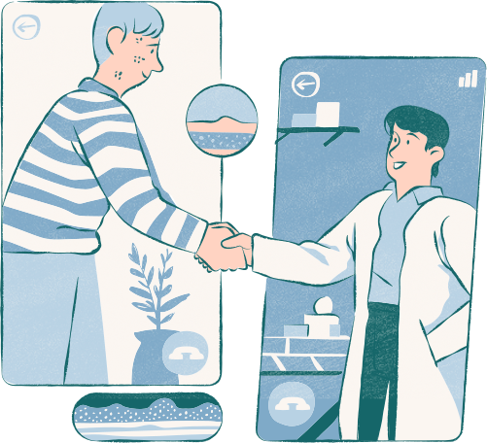
Patient Engagement
Hub
Deepali Mahar
12112535
IXD803
CA-3

Slide 2

Problem Statement
Design a solution for patients giving them a complete picture of their health, appointments, and visits. This solution will act as a self-service portal for the patients and will engage them by providing the right information and actions for them to have a seamless healthcare experience.

Slide 3



Objective and Target Audience
Patients with Chronic Conditions: Those requiring regular follow-ups benefit from easy access to health records and appointment scheduling.
Proactive Health Managers: Patients focused on preventive care who want convenient tools to track wellness.
Older Adults and Caregivers: Older patients or family caregivers who need user-friendly access to health information, and appointments in one place.

Slide 4
Simple Access to Health Records and Data
Users need quick, organized access to health records and test results to avoid feeling overwhelmed. This clarity encourages regular app use and keeps patients informed.
01.
Brainstorming
The Patient Engagement Platform aims to empower patients by centralizing their health data, and care information in a self-service app. By providing intuitive navigation, timely insights, and interactive tools, the platform enhances user engagement and promotes proactive healthcare management. It’s crafted to meet users' needs at every step of their healthcare journey—whether for ongoing treatment, preventive care, or simply staying informed.
Streamlined Appointment Management
For users with chronic conditions, managing appointments should be effortless. Features like reminders, rescheduling, and post-visit summaries support consistent, engaged care.
02.
Personalized Insights and Notifications
Proactive users benefit from timely reminders for appointments, preventive care, and record updates, empowering them to take control of their health journey.
03.

Slide 5
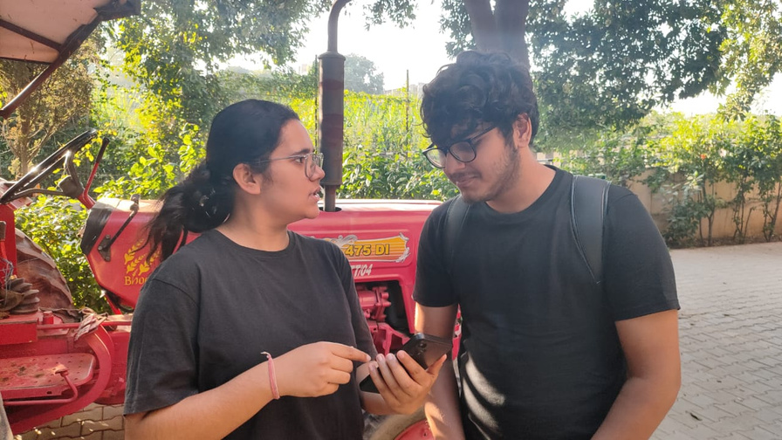
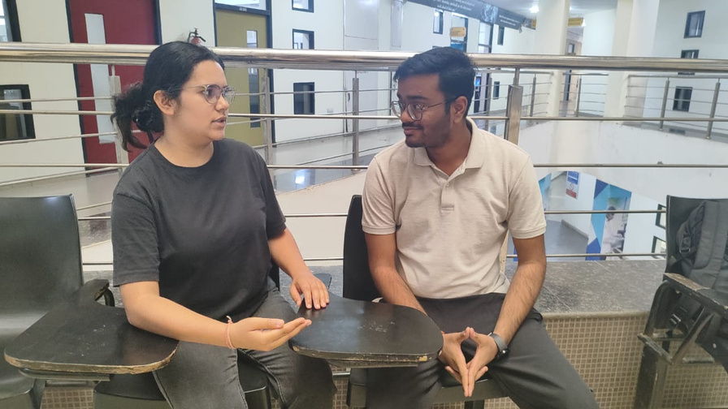

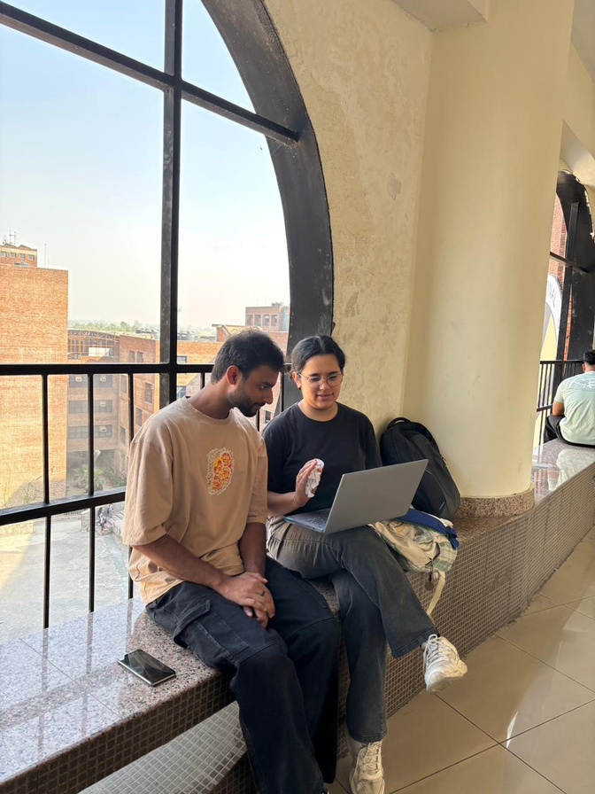
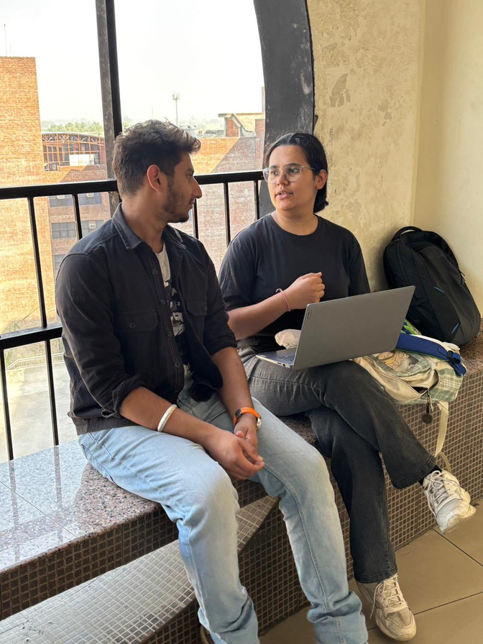
Interviews

Slide 6
Interview
Questions
1. Healthcare Management
What challenges do you face in keeping track of medical appointments, test results, or follow-up care?
How often do you review your health information, and which types of updates are most important to you?
3. Technology Comfort Level
How comfortable are you with using apps for managing healthcare information?
How important is data security and privacy to you when accessing health information digitally?
4. User Engagement Preferences
What types of health updates or notifications would you like to receive regularly?
How often would you like access to health tips, reminders, or insights to support your healthcare journey?

Slide 7
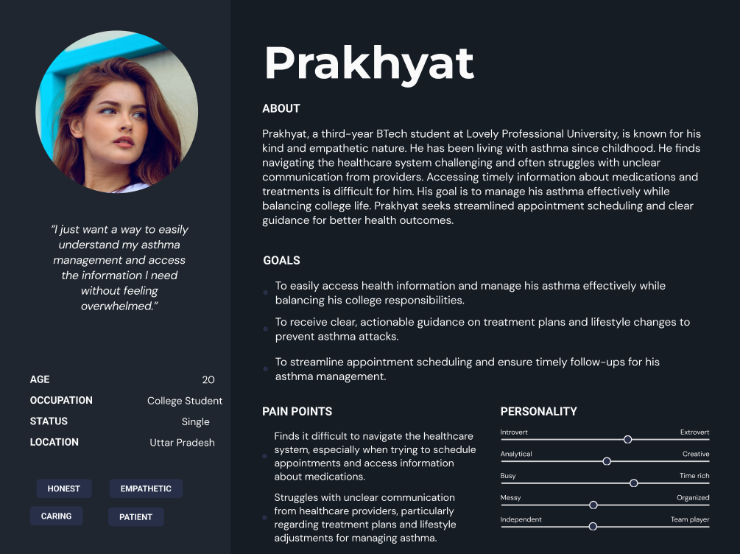

User
Persona
1

Slide 8
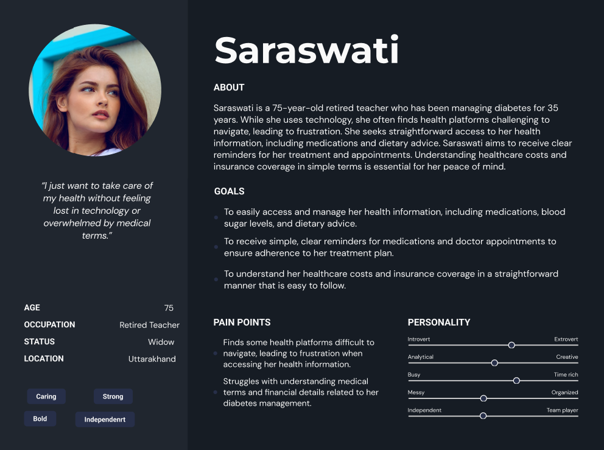

User
Persona
2

Slide 9
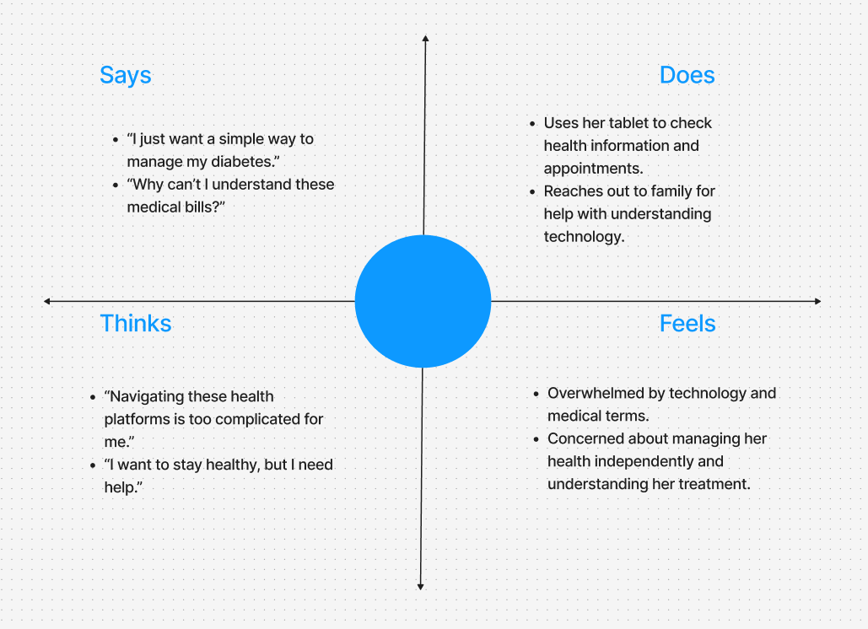
Empathy
Mapping
1

Slide 10
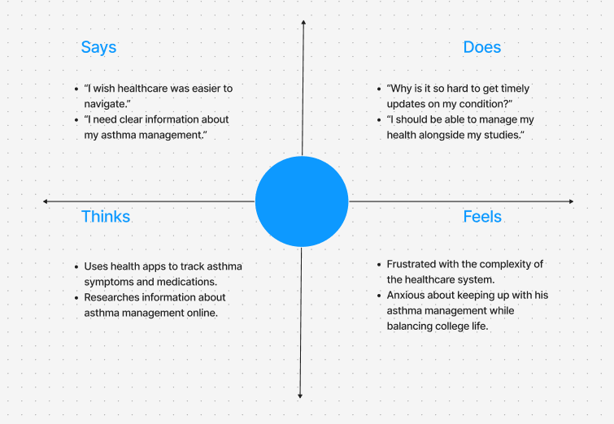
Empathy
Mapping
2

Slide 11
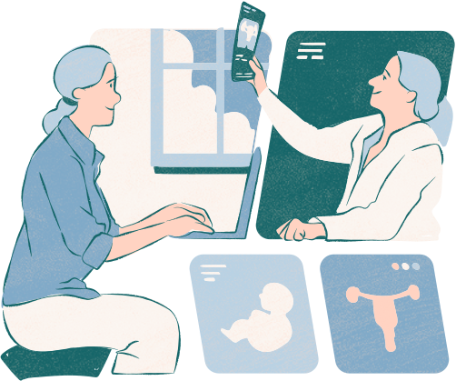
Scenario 1: Missed Follow-Up Appointment
Question: A patient with a chronic condition missed a scheduled follow-up appointment and forgot to reschedule. How can the app help ensure that patients don't miss critical follow-ups?
Solution: The app could send timely reminders before the appointment, with a clear option to confirm or reschedule. If a patient somehow can’t make it to the appointment, they will be given an option to reschedule with a quick tap.

Slide 12
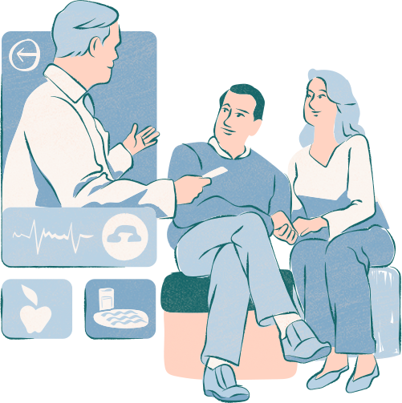
Scenario 2: Accessing Test Results and Personalized Health Insights
Question: A patient has just completed several medical tests and wants to understand the results and how they impact their treatment. How can the app enhance understanding and engagement in this scenario?
Solution: The app could provide a section where test results are displayed in simple language, alongside insights into what each result means for the patient’s health.

Slide 13
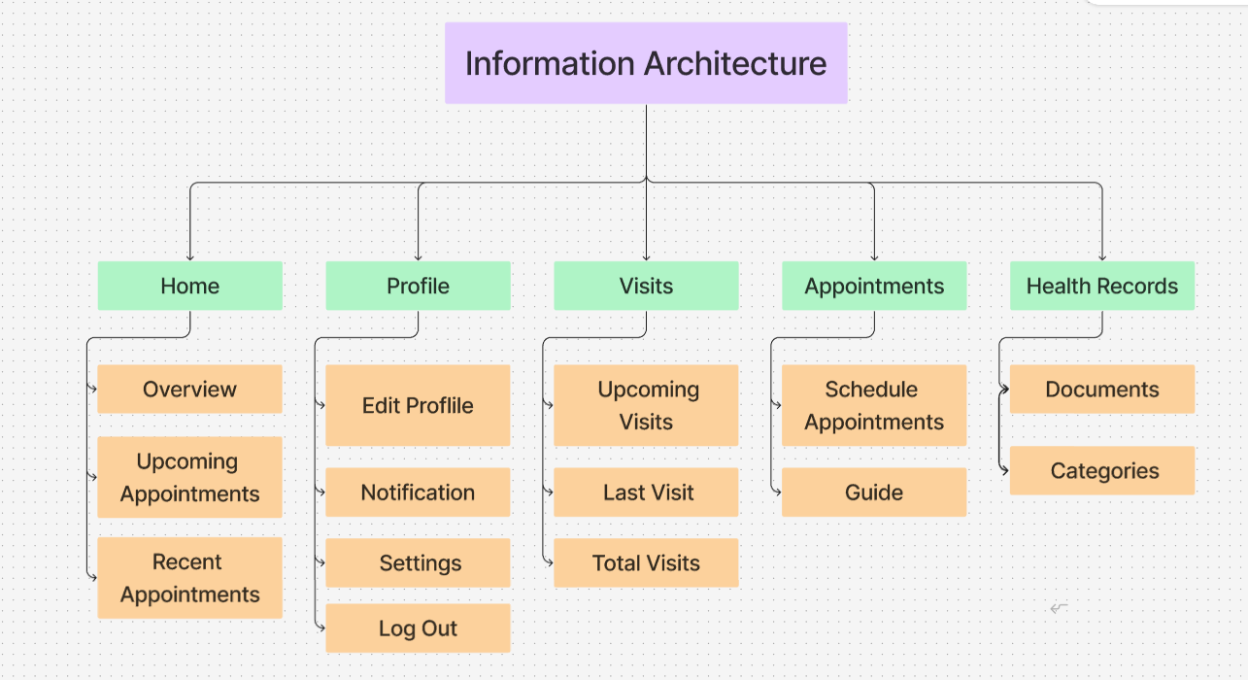
Information
Architecture

Slide 14
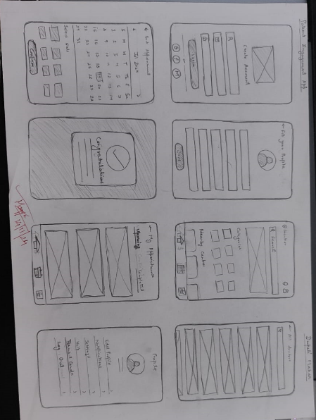
Low
Fidelity Wire-
frames

Slide 15
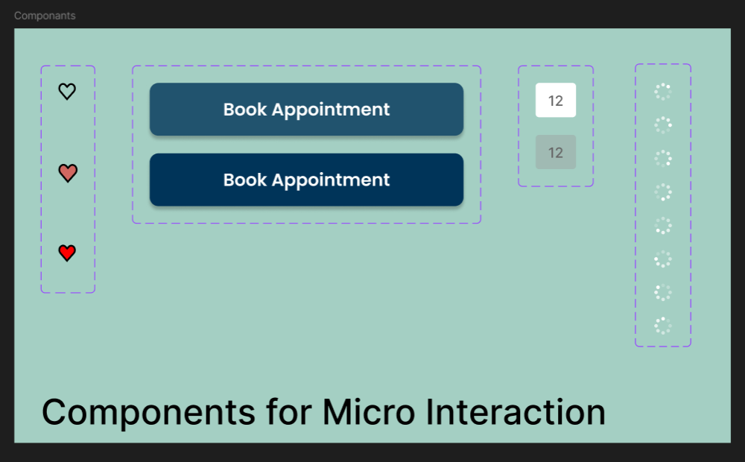
Main UI Screens

Slide 16
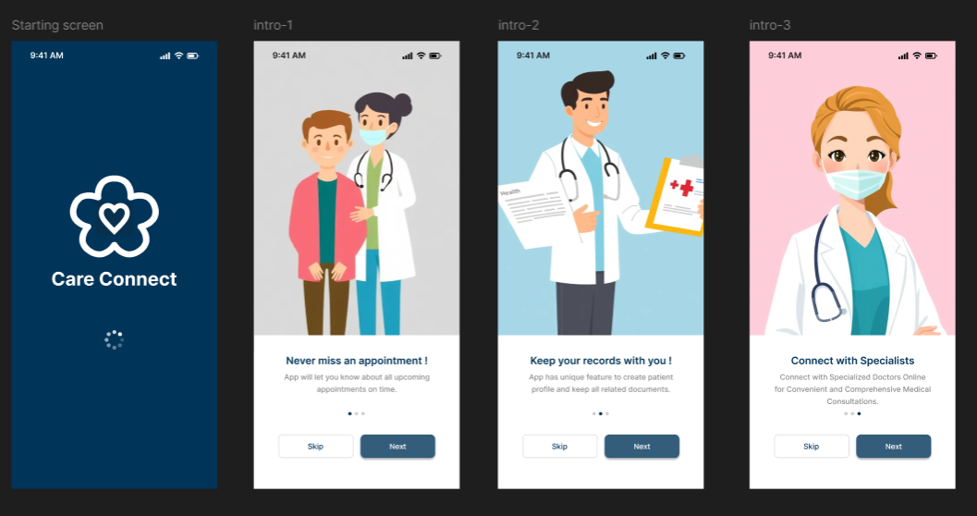

Slide 17
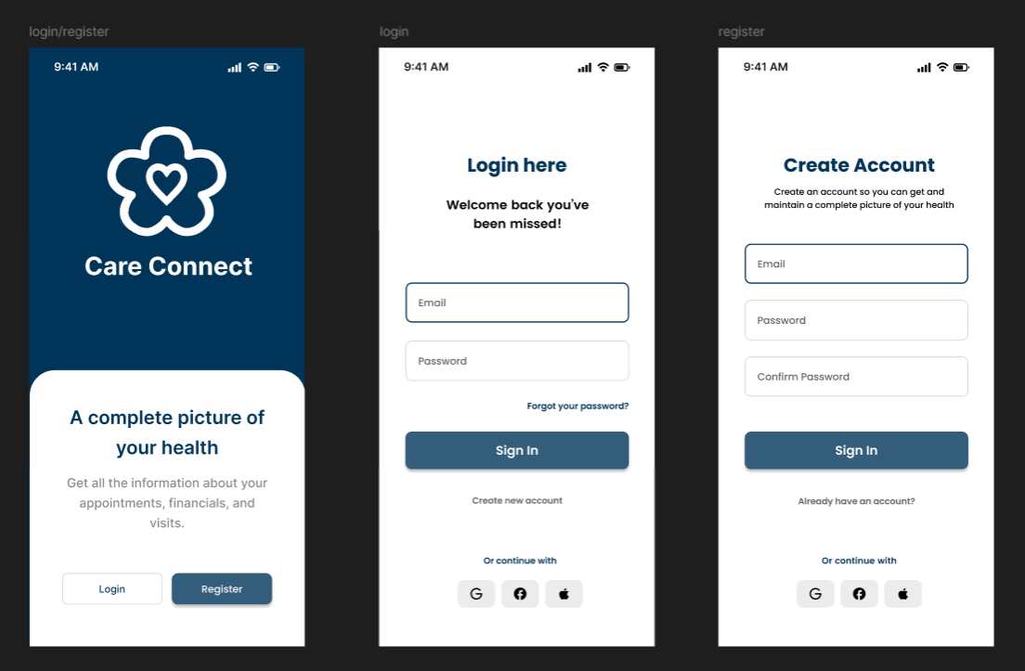

Slide 18
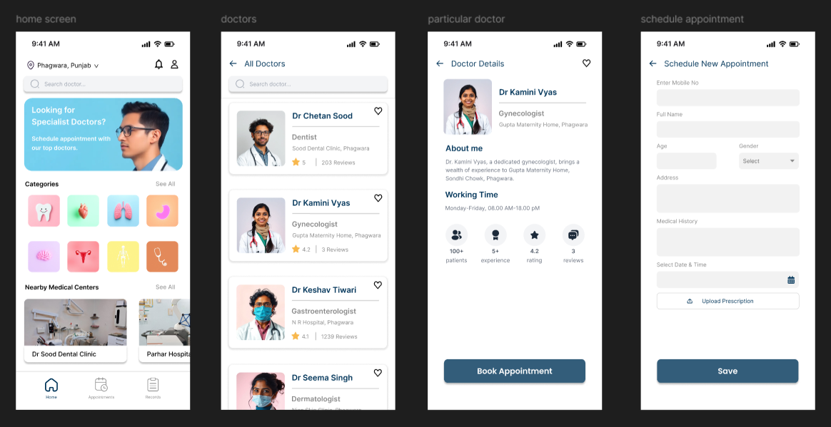

Slide 19
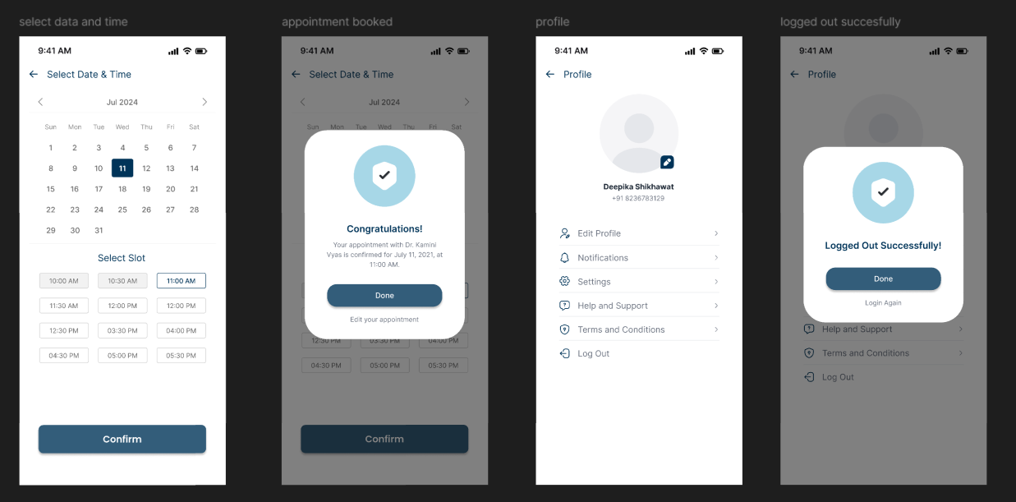

Slide 20
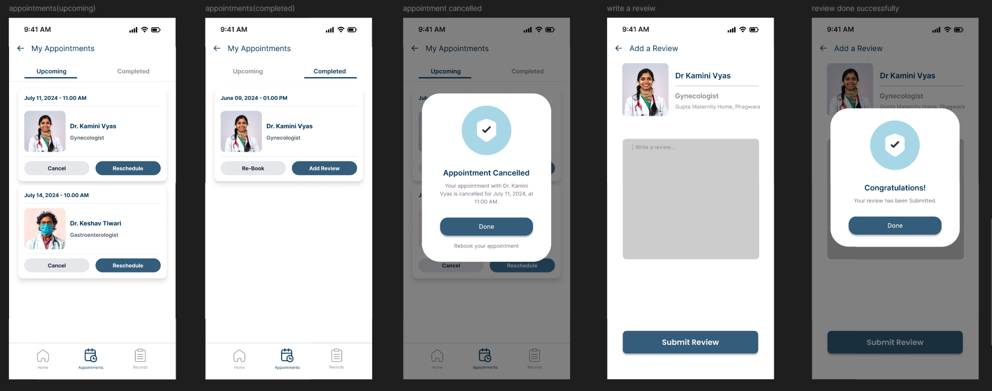

Slide 21
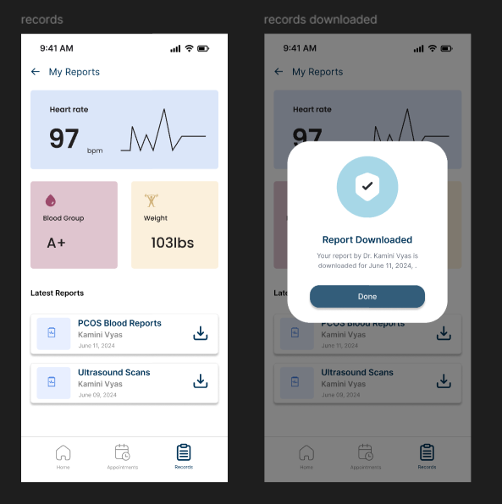

Slide 22

Figma Link
https://www.figma.com/design/kLSqpyOnSSWjwu9rQzlLfK/Patient-Engagement?node-id=0-1&t=UhMCiU3XCZR7buZN-1

Slide 23

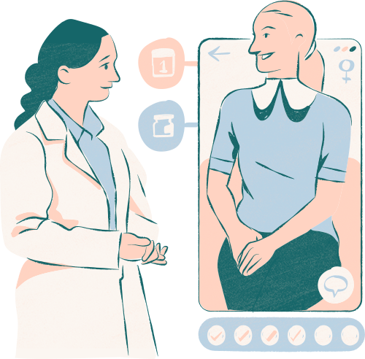
Thank you very much!

